Slide 1
Conversion from Latitude/Longitude to Cartesian Coordinates

Slide 2
Geodetic Datums
Define the shape and size of the earth.
Reference points on a coordinate system used to map the earth.
There are hundreds of datums currently in use; all are either vertical or horizontal in orientation.

Slide 3
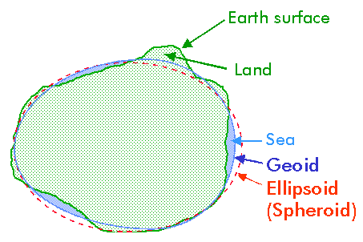
Vertical Datums
Defines a system of zero surface elevation
This surface is then used to reference heights
Many vertical datums reference the geoid as a surface of zero elevation
The geoid can be described as the surface of the earth if it was completely covered by water. This surface would be smooth but highly irregular reflecting changes in gravity due to the earth irregular surface.

Slide 4
Horizontal Datums
Forms the basis of horizontal coordinates
Earth is modeled as an ellipsoid
The center of the ellipsoid must coincide with the earths center of mass
A datum is then placed on the ellipsoid for reference

Slide 5
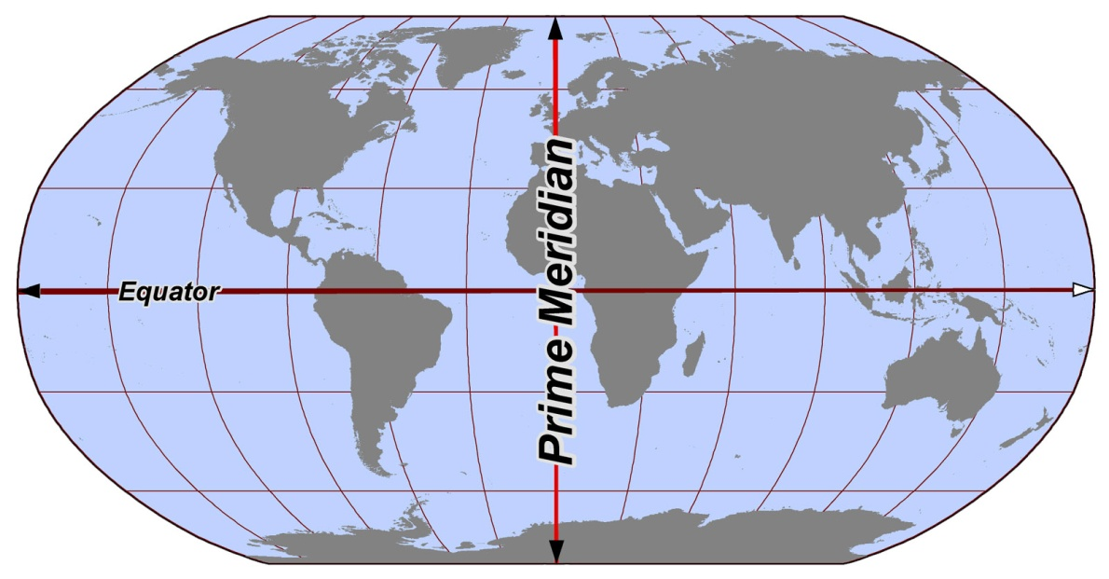
World Geodetic System 1984
The reference coordinate system used by GPS
Globally consistent within ± 1 meter
Datum is located at where the Prime Meridian and Equator cross

Slide 6
WGS 84 Coordinates
WGS 84 are used by GPS systems
Land Surveys conducted with GPS will consist of WGS 84 coordinates with coinciding elevation measurements.

Slide 7
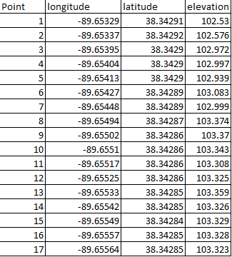
WGS 84 Survey
Surveys in this raw form are not very useful.
The longitude and latitude are simply references to the WGS 84 datum measured in degrees
The elevation is measured in a unit of length from a reference geodic elevation

Slide 8
WGS 84 Survey
Longitude and latitude do not provide measurements of length .
Without measurements of length, one cannot calculate area, volume, or slope.

Slide 9
Cartesian Coordinates
A better way to represent these data would be in a Cartesian form
(X,Y,Z) in units of (length,length,length)
- i.e. (m,m,m) or (ft,ft,ft)
There is a need to find a practical way to convert (degrees longitude, degrees latitude, m) to (m,m,m)

Slide 10
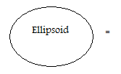
Assumptions
In order to convert from degrees to meters. Assume that the ellipsoidal based datum of the WGS 84 system can also be modeled as a sphere.

Slide 11
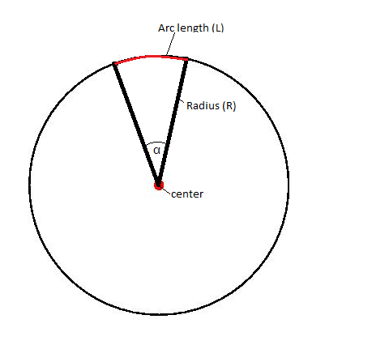
Assumptions
This allows a constant earthly radius (R)
The radius of the earth is approximately 6,371 km (3,959 mi)

Slide 12
Arc Length at Equator
The ratio of the arc length and circumference is equal to the ratio of α and 2π radians
Circumference (C)
2π radians

Slide 13
Arc Length at Equator
Now let use choose a value for α.
To keep it simple we will choose 1⁰ ( π/180 radians)
Circumference (C)
2π radians

Slide 14
Arc Length at Equator
C = 2πR
α = π/180
R= 6,371 km
L = 111.19 km
( at the equator)
Circumference (C)
2π radians

Slide 15
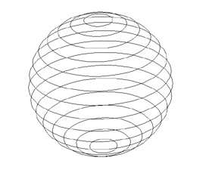
Arc Length
This value of 111.19 km represents the distance between one degree of longitude at the equator
A new radius must be calculated for all other parallels

Slide 16
Arc length at Latitude α
α = degree of latitude of the location
Alternate interior angles
r
R
r = R cos(α)

Slide 17
Length of One Degree of Longitude (on WGS 84 Ellipsoid) |  |  | Length of a Degree of Latitude (on the WGS 84 Ellipsoid)
Latitude | Kilometres | Miles | Latitude | Kilometres | Miles
0º | 111.32 | 69.17 | 0º | 110.57 | 68.71
10º | 109.64 | 68.13 | 10º | 110.61 | 68.73
20º | 104.65 | 65.03 | 20º | 110.70 | 68.79
30º | 96.49 | 59.95 | 30º | 110.85 | 68.88
40º | 85.39 | 53.06 | 40º | 111.04 | 68.99
50º | 71.70 | 44.55 | 50º | 111.23 | 69.12
60º | 55.80 | 34.67 | 60º | 111.41 | 69.23
70º | 38.19 | 23.73 | 70º | 111.56 | 69.32
80º | 19.39 | 12.05 | 80º | 111.66 | 69.38
90º | 0.00 | 0.00 | 90º | 111.69 | 69.40
At the equator, the distance of between one degree of latitude of WGS 84 is 111.32 km. This is close to 111.17 km. ( less than one percent error) Proving that the circular assumption is valid.

Slide 18
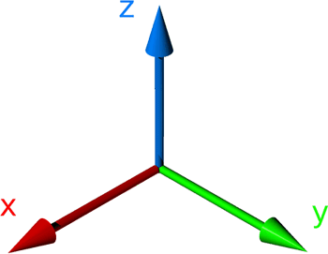
Choosing a Datum
In order to assign Cartesian values to WGS 84 coordinates, we must establish a datum from which each point will be referenced from.
A wise choice for a field survey datum would be the minimum observed longitude, latitude, and elevation. Doing this will assure that all the converted data will be positively referenced from the datum.
This will allow for the data to fit exclusively into the first quadrant when plotted.

Slide 19
Referencing Longitude from Datum
Example:
Minimum longitude = -89.6579
Observed longitude = -89.65741
Observed latitude = 38.34133
R = 6,371 km
X = .04273 km
X= 42.73 m

Slide 20
Referencing Latitude from Datum
Example:
Minimum latitude= 38.33916
Observed latitude= 38.34133
241.29 m

Slide 21
Determine the area (in square miles) bounded by Mount Zion, DeLand and Monticello, three towns in Illinois.
Let a, b and c be the lengths of the three sides of the triangle. The area of this triangle is given by:
Area = Sqrt [ s * (s - a) * (s - b) * (s - c) ]
where s = (1 / 2)(a + b + c).

Slide 22
Using Excel to Convert Data
It is practical to use Microsoft Excel or another program to convert data from Lat/Long to Cartesian Coordinates. An Excel template was created for this conversion.

Slide 23
Excel Template

Slide 24
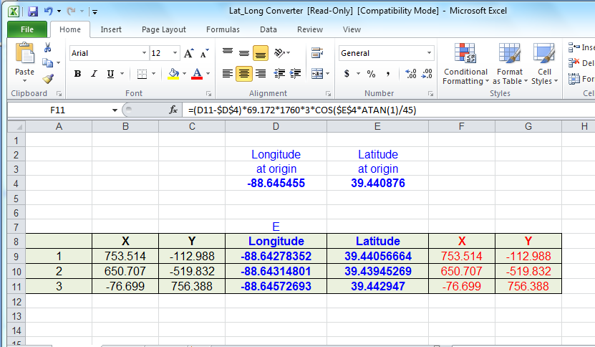
Excel Template

Slide 25
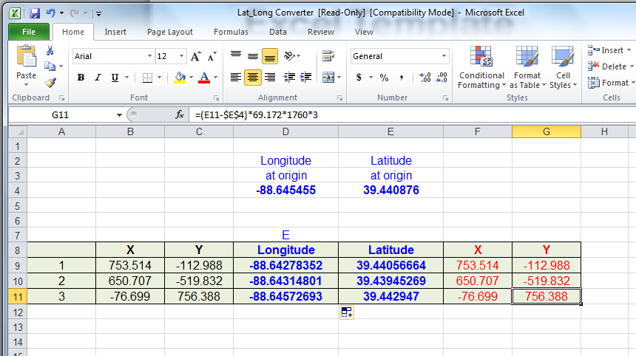
Excel Template

Slide 26
Excel Template

Slide 27
Excel Template

Slide 28
Excel Template

Slide 29
Excel Template

Slide 30
UTM projection
Universe Transverse Mercator
Conformal projection (shapes are preserved)
Cylindrical surface
Two standard meridians
Zones are 6 degrees of longitude wide

Slide 31
UTM zones

Slide 32
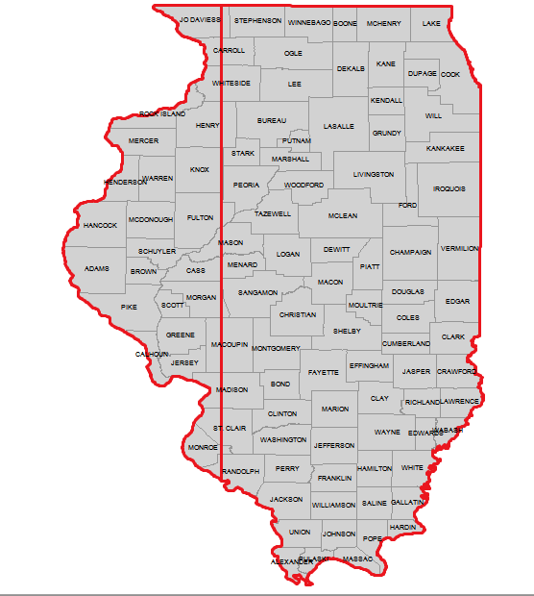
Zone 16
Zone 15

Slide 33
State Plane Coordinate System
System of map projections designed for the US
It is a coordinate system vs a map projection (such as UTM, which is a set of map projections)
Designed to minimize distortions to 1 in 10000

Slide 34
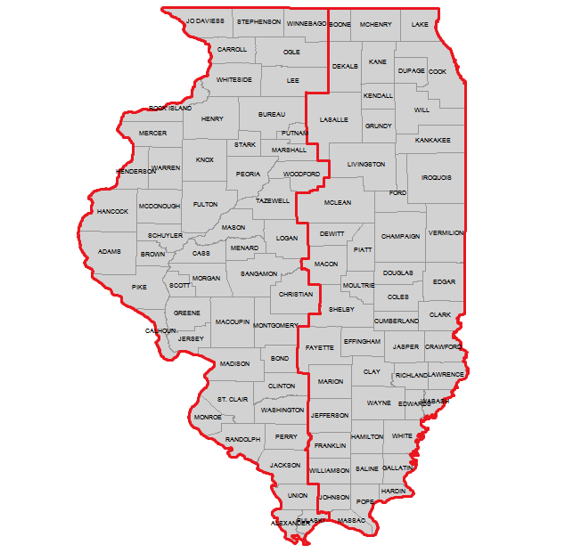
Illinois East
1201
Illinois West
1202

