Slide 1
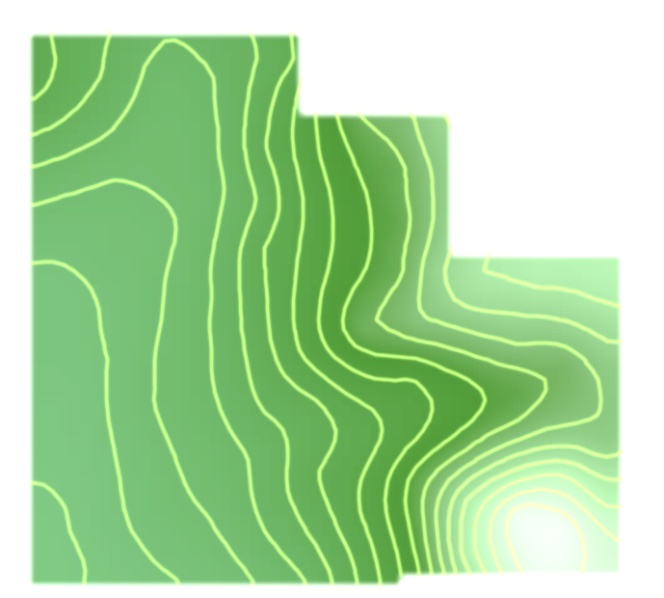
Map Projections

Slide 2
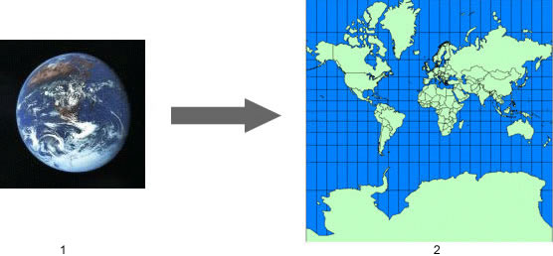
What is a Map Projection?
A mathematical expression used to represent the 3D surface of the earth on a 2D map
Always results in distortions
Source: http://support.google.com/earth/bin/answer.py?hl=en&answer=148111

Slide 3
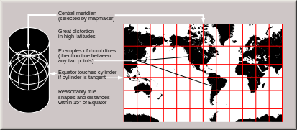
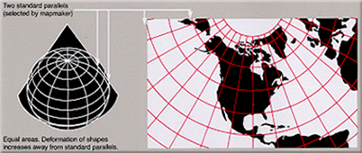
Projection Surfaces
Cylindrical
Meridians and parallels are equidistant, straight lines, crossing at right angles
Conical
Parallel(s) that are touching the cone are assigned unitary scale
Planar
Point or circle that intersects tangent plane has no distortion
Source: http://en.wikipedia.org/wiki/Map_projection#Projections_by_surface

Slide 4
Preservation of a Metric Property
Conformal- Preserves angles locally (MapWindow uses this projection exclusively)
Equal-area- Preserves area
Equidistant- Preserves distance from a standard point or line
Gnomonic- Preserves shortest route between two points (great circles projected as straight lines)
Azimuthal- Preserves cardinal directions
Compromise- Balancing/minimizing overall distortion
Source: http://en.wikipedia.org/wiki/Map_projection#Projections_by_surface

Slide 5
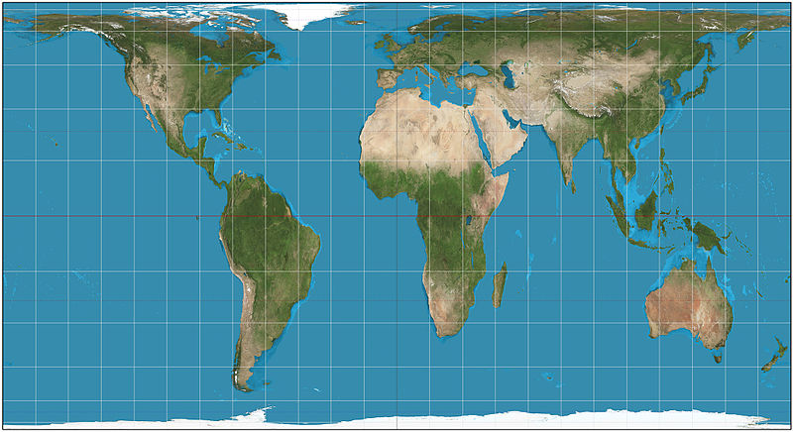
Projection Comparison
Equal Area Projection
Equal Angle Projection

Slide 6
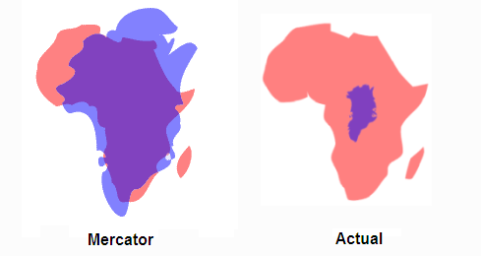
Universal Transverse Mercator
Lat/Lon WGS84 (UTM) used in Google Earth and MapWindow
Topographical maps, geological maps
Cylindrical, conformal
Large distortions at the poles
Greenland (blue) vs. Africa (red) example
Source: http://support.google.com/earth/bin/answer.py?hl=en&answer=148111
http://www.pratham.name/mercator-projection-africa-vs-greenland.html

Slide 7
MapWindow Project Projections
Download and extract Map Projections Sample Projects folder Open project in MapWindow > Sample Projects > World > World.mwprj
Click “Ignore Mismatch” if prompted
Assigning a projection to a project: Project > Settings

Slide 8
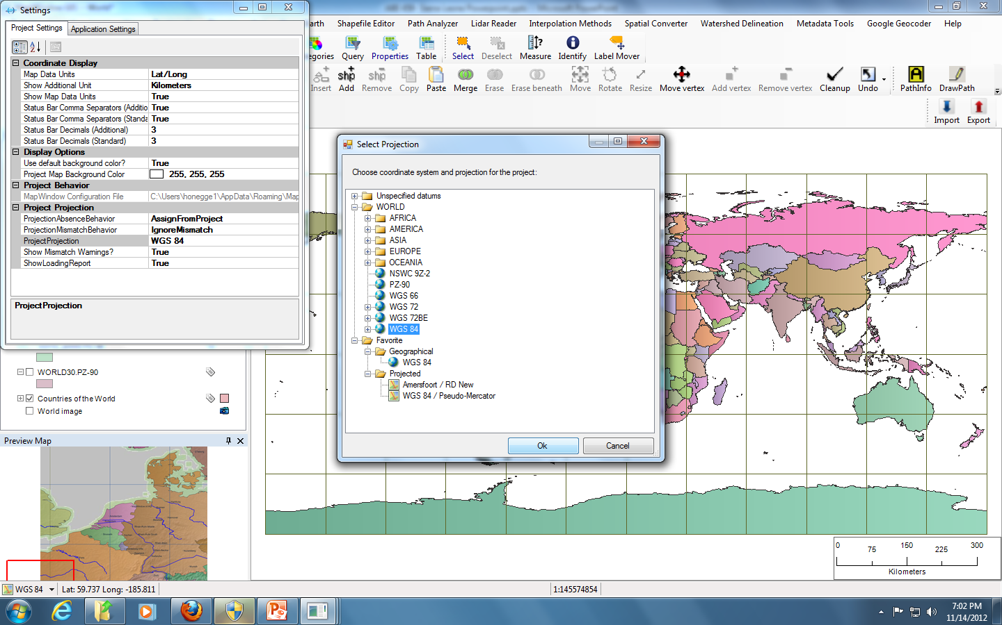
MapWindow Project Projections
Click on “Project Projection” and choose the projection you wish to apply to the entire project (may require restart of the project)

Slide 9
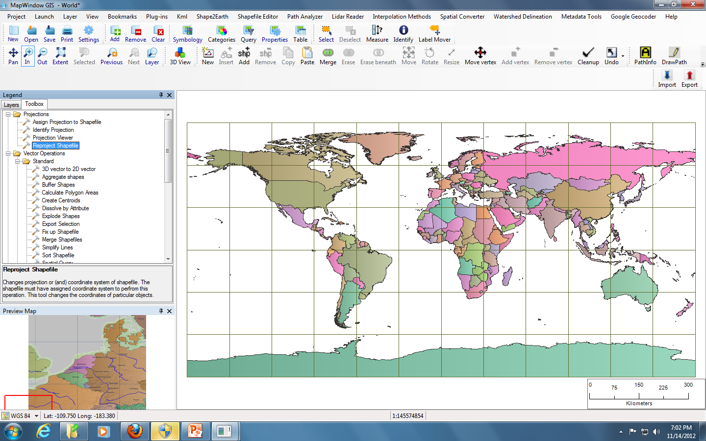
MapWindow Shapefile Projections
Go to the Toolbox tab (or GIS plug-in) to reproject, assign projections, etc. to shapefiles, grids, and/or images

Slide 10
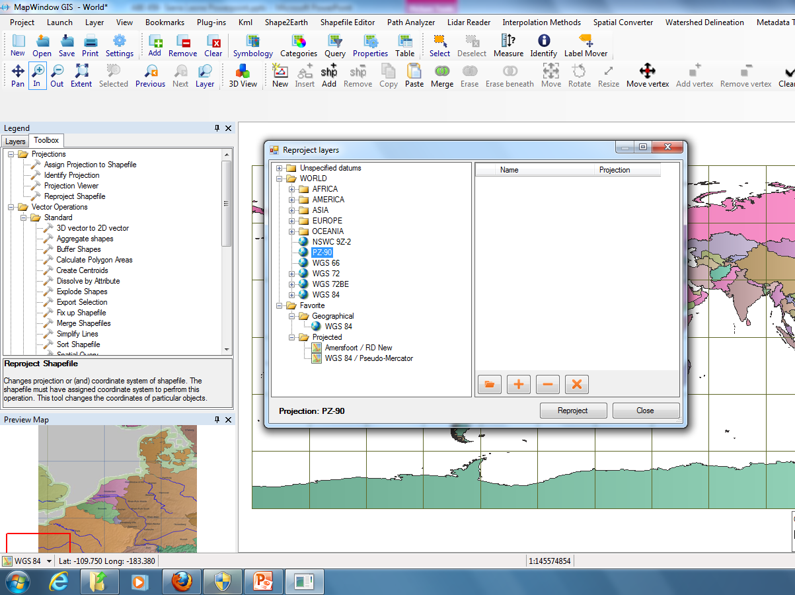

Slide 11
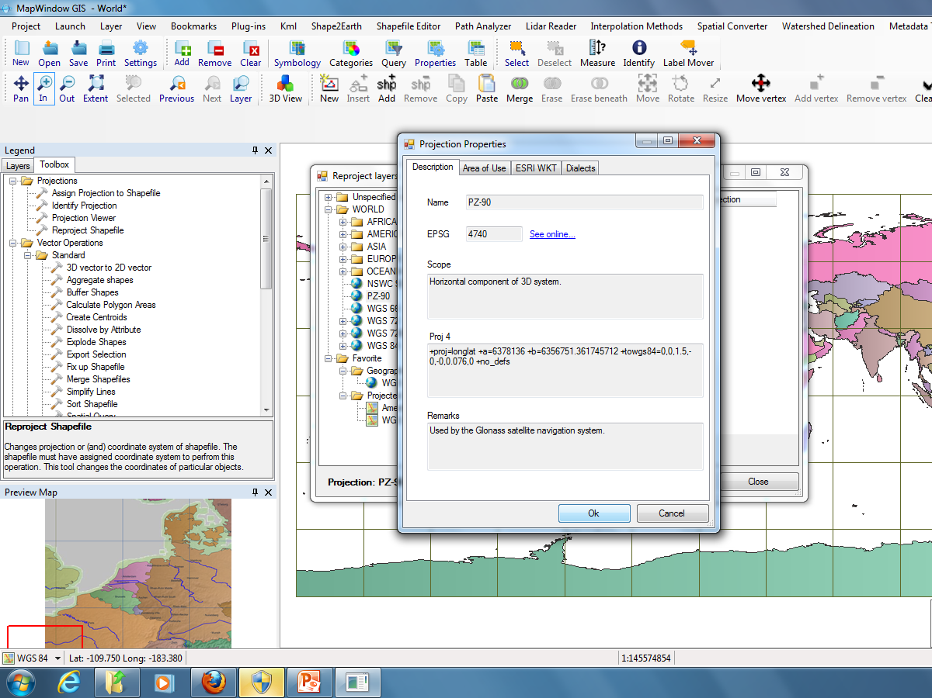

Slide 12
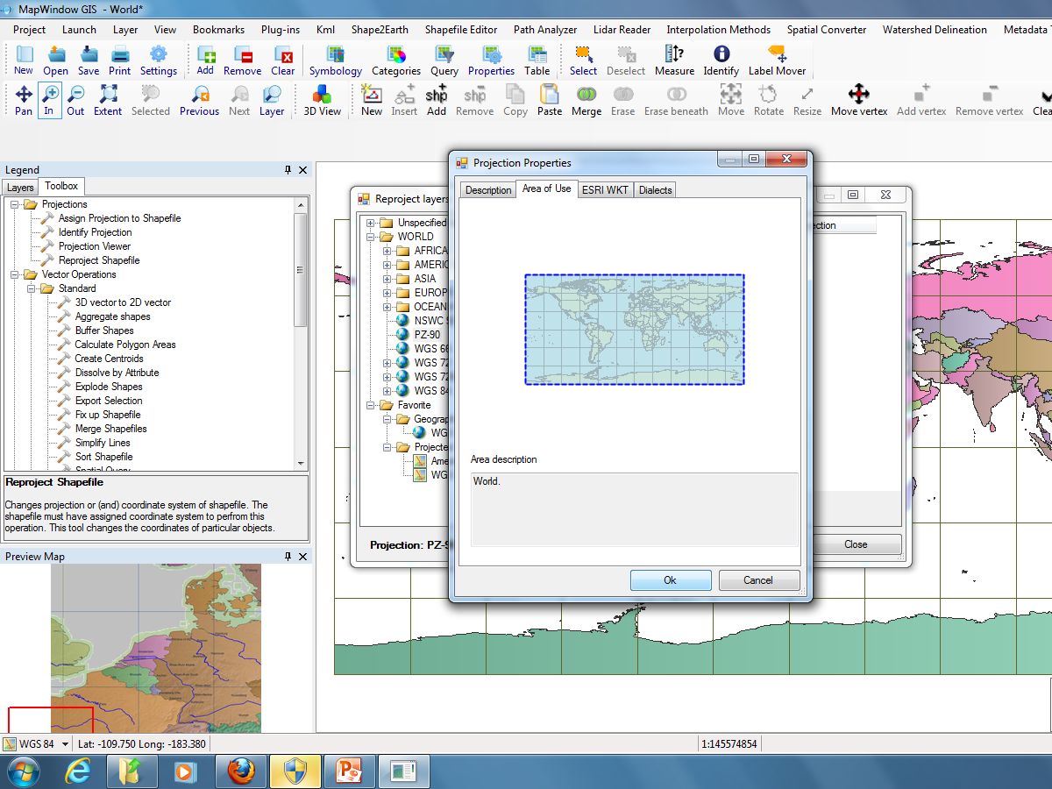

Slide 14
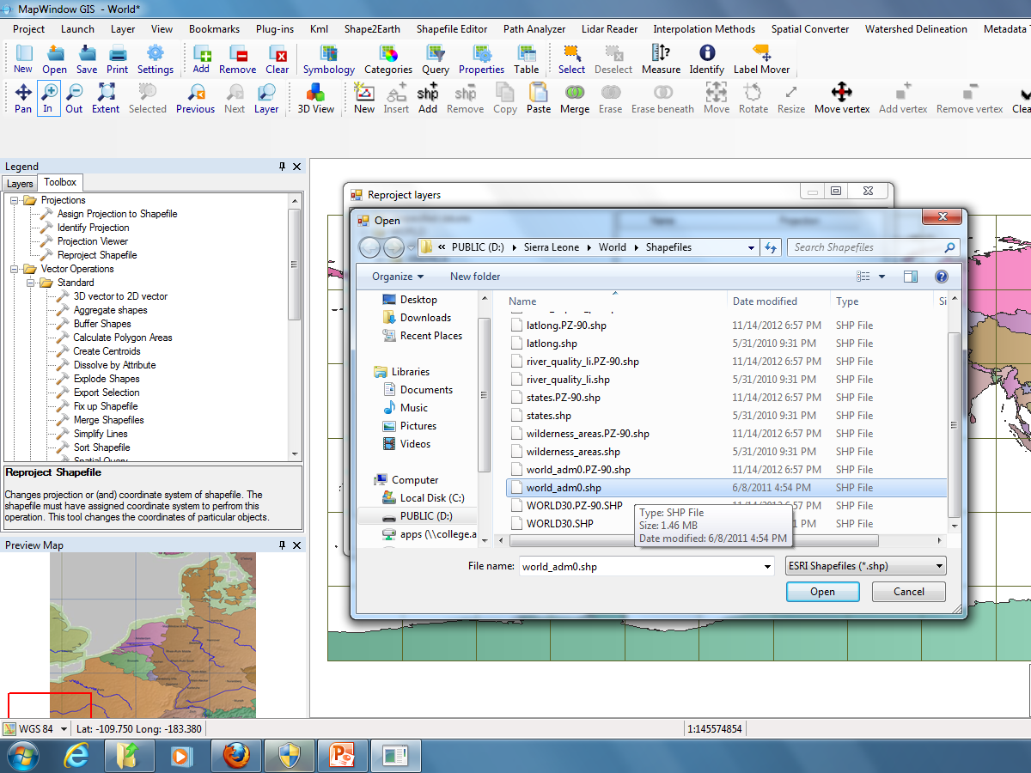

Slide 15
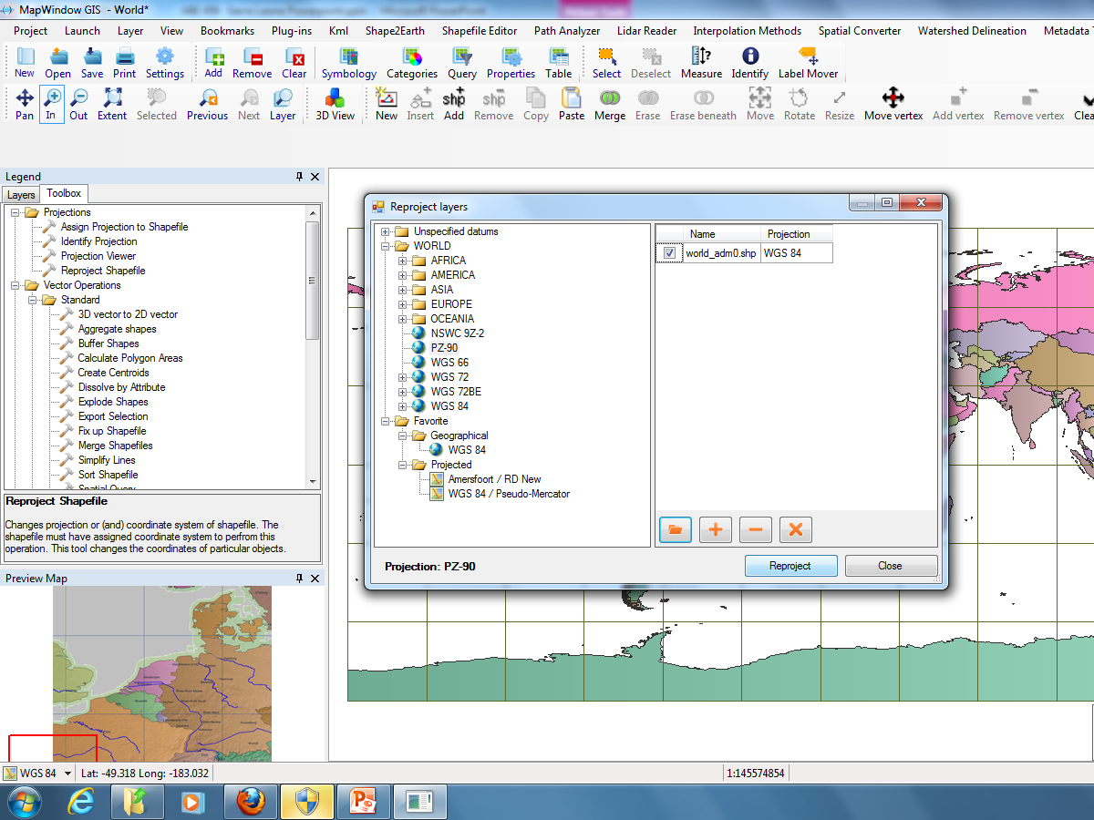

Slide 16
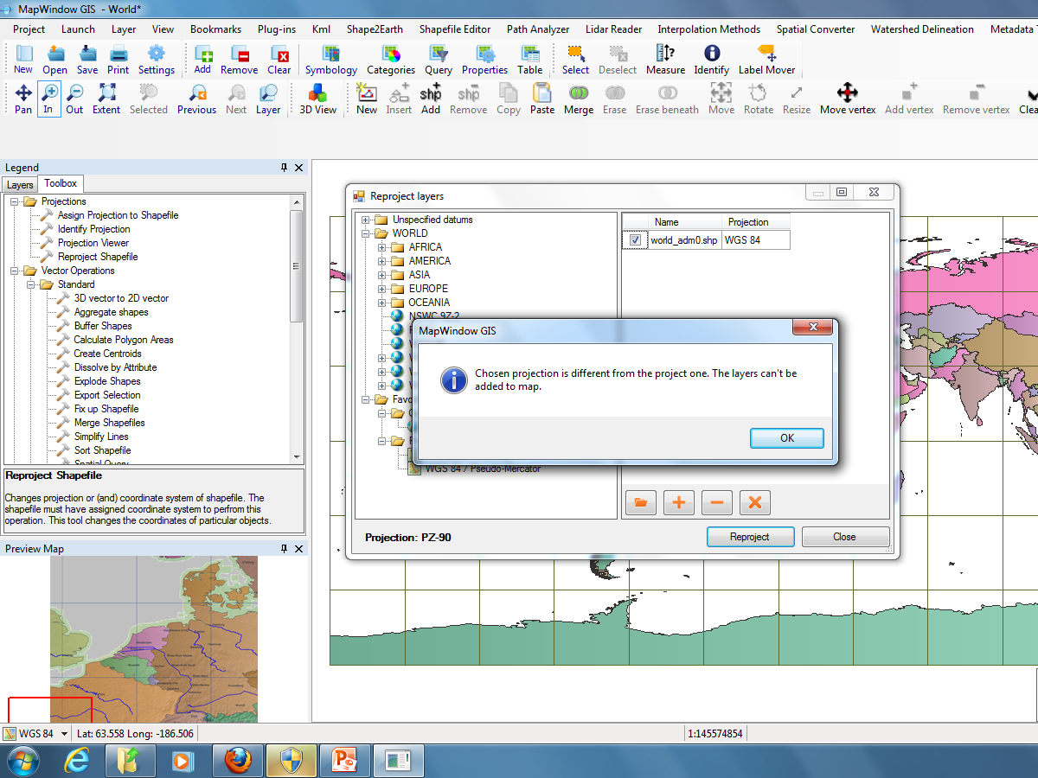

Slide 17
Add the reprojected shapefile as a map layer to compare projections
Select “Ignore Mismatch” if prompted

Slide 18
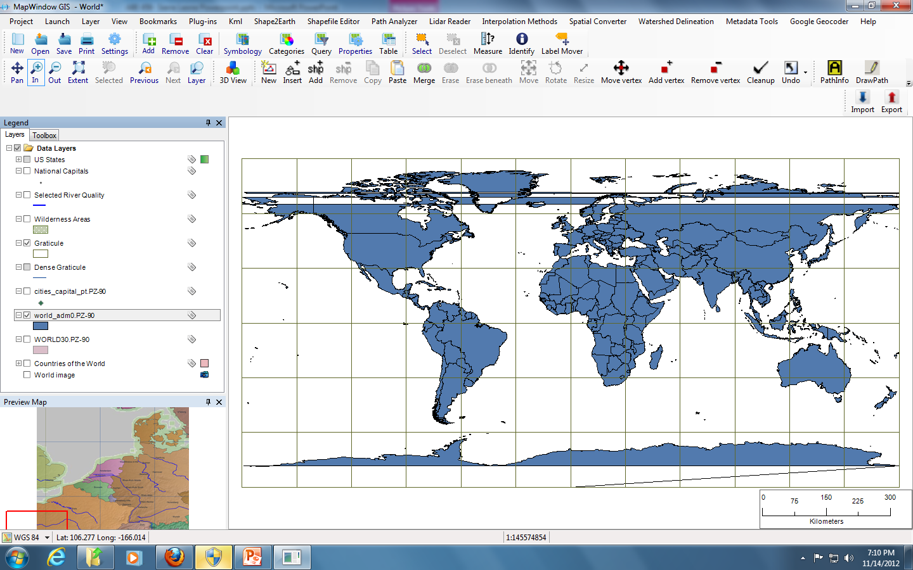
PZ-90 Reprojected Shapefile

Slide 19
Calculating Area to Compare Projections
Go to the Toolbox > Standard > Calculate Polygon Area

Slide 20
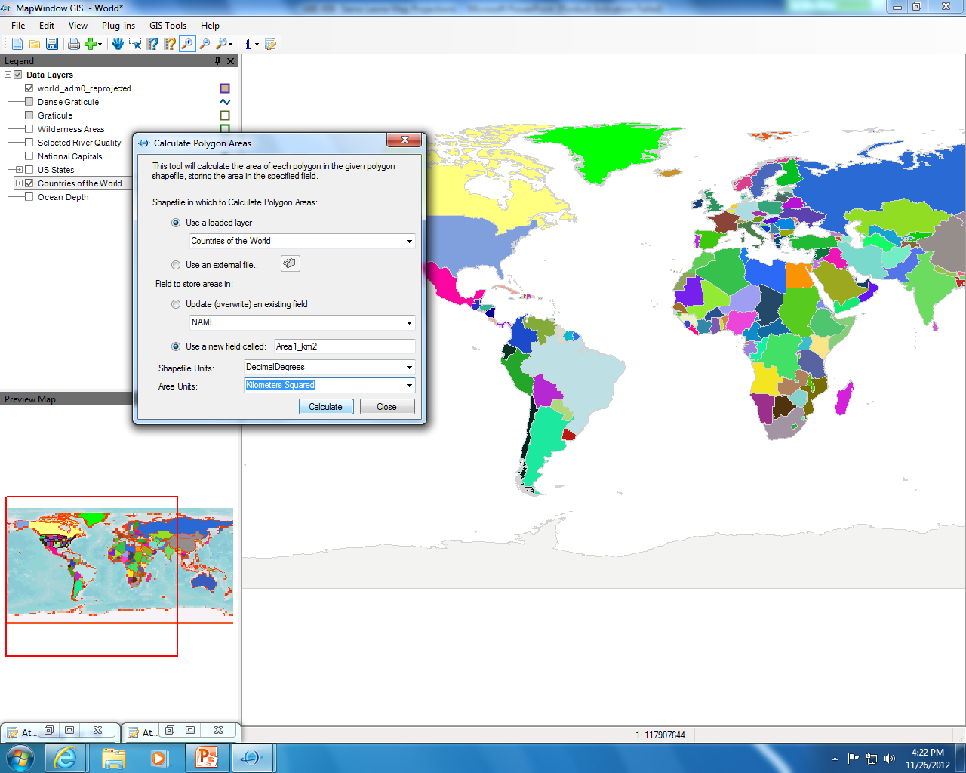
Layer or shapefile
Name of field in table
Units

Slide 21
Calculated area of each shape (country) in km^2 using our original projection (WGS84)

Slide 22
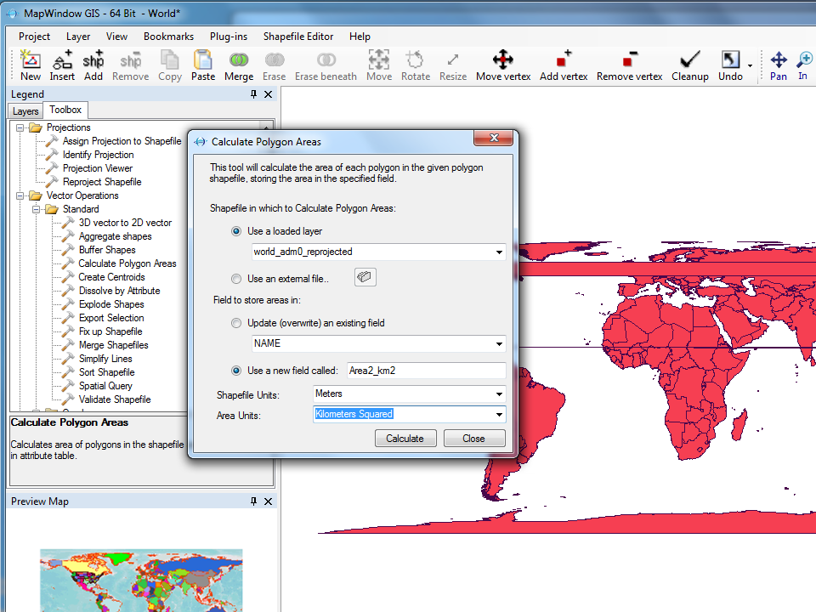
Calculate the area of each country using our reprojected shapefile

Slide 23
Compare areas (in km^2) of Zaire from two different projections:
WGS84 (1)
Africa Albers Equal Area Conic (2)

Slide 24
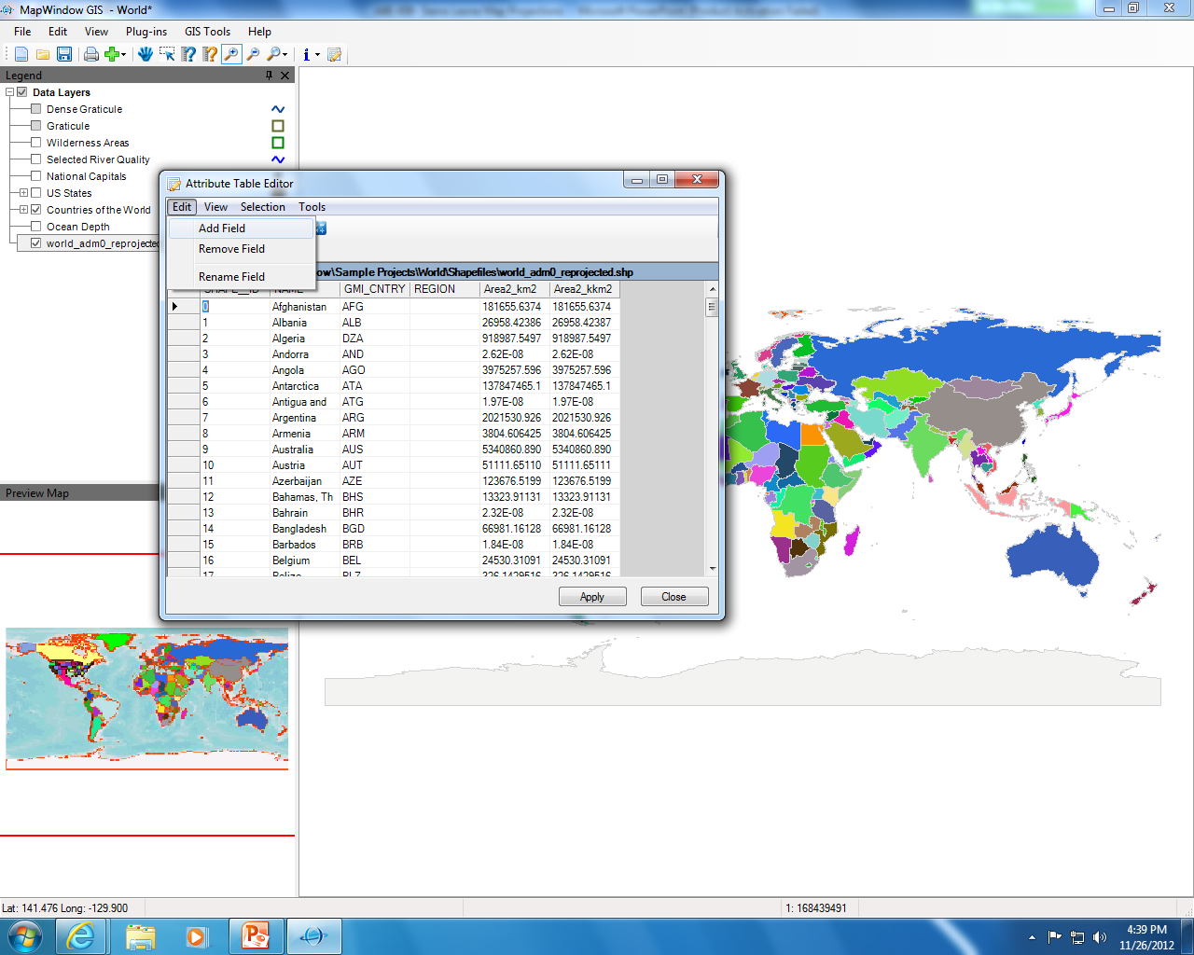
Add a column to the table to display the area in 1000 km^2 (kkm^2)

Slide 25
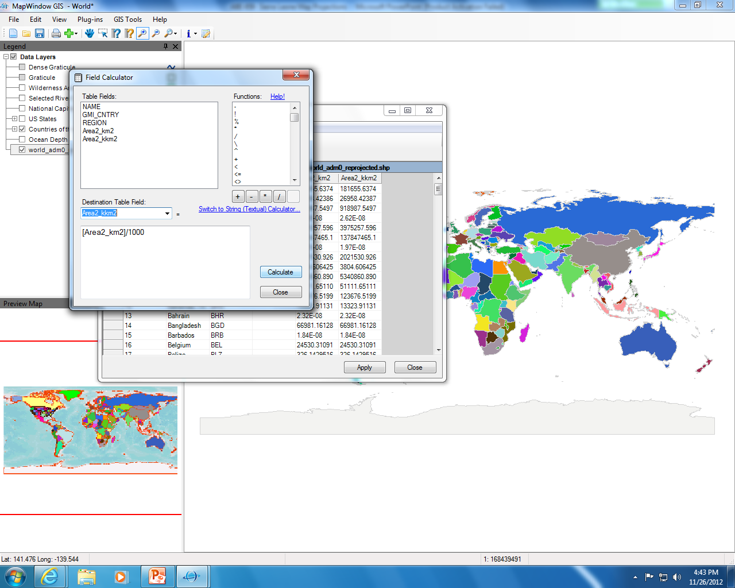
New column
Equation

Slide 26
Compare areas (in kkm^2) of
Greenland from two different projections:
WGS84 (1)
Africa Albers Equal Area Conic (2)

Slide 27
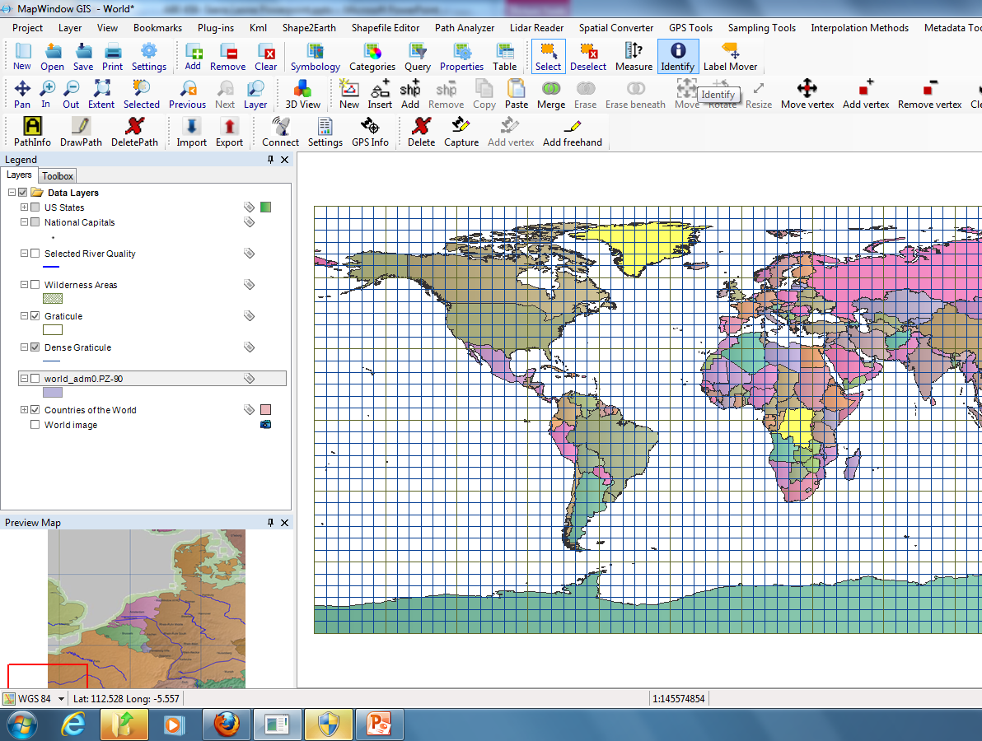

Slide 28
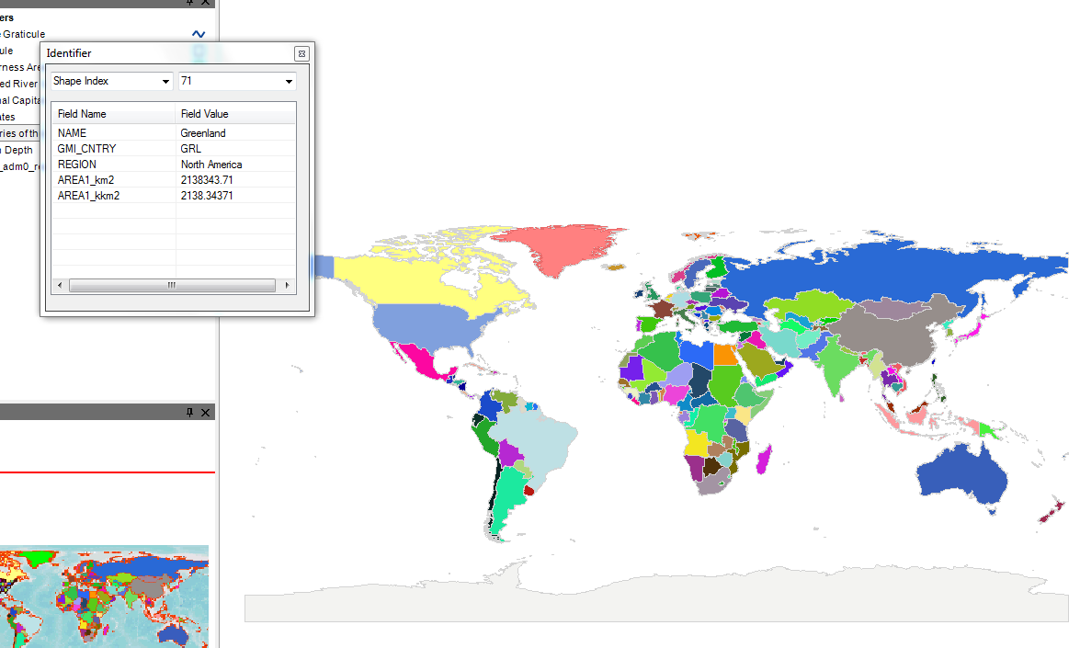
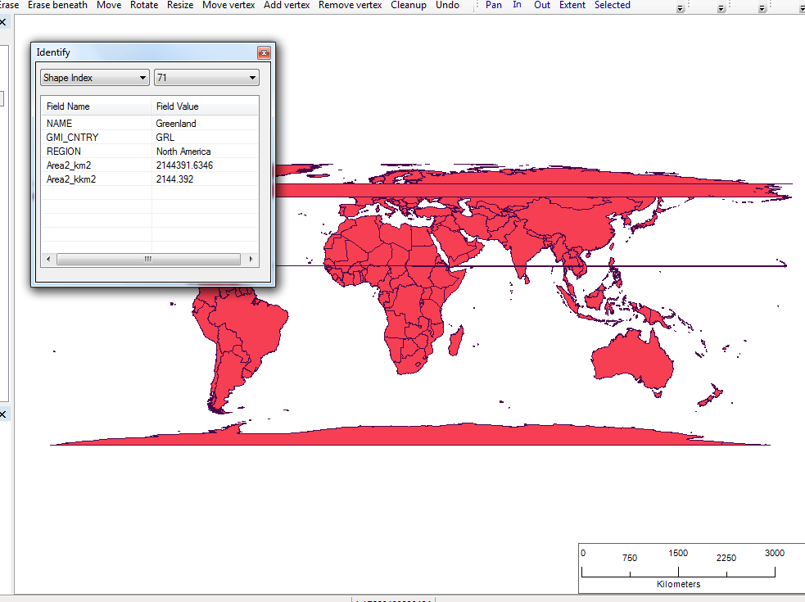
Different projections calculate different areas for the same country

